Slide 1

3. Exploratory Data Analysis
Slides Prepared By:
Thomas James Tiam-Lee
thomas.tiam-lee@dlsu.edu.ph

Slide 2

Exploratory Data Analysis
Exploratory Data Analysis (EDA) is an approach to analyzing datasets to summarize their main characteristics, often with visual methods.
Gain a better understanding of the data
Possibly form new hypotheses leading to more data collection and experiments

Slide 3
Steps Involved Around EDA
Data cleaning
Correcting parts of the dataset that may be missing, inaccurate, or in the incorrect format.
Data validation
Validating if the data makes sense, or if there are problems with the way it is collected / recorded.
Data visualization
Visualizing the data to get a better understanding of it.

Slide 4

Data Cleaning
Raw data is inherently dirty.
Some issues may include:
Spelling / encoding errors
Incorrect data types
Non-ideal formats
Missing values
and others…
In data cleaning, we aim to address these problems in the dataset to prevent them from causing problems in analysis.

Slide 5
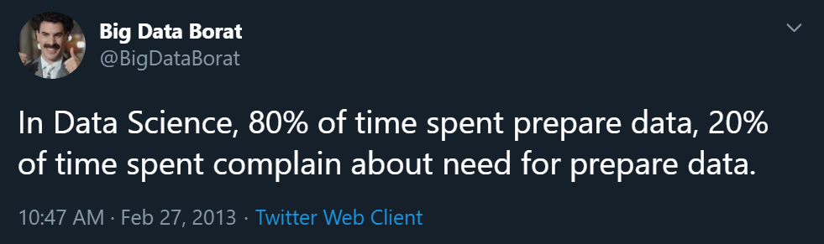
Data Cleaning

Slide 6
Common Issues that Require Cleaning
Data are in separate files
Multiple representations of strings (spellings)
Numerical values from strings
Default values / placeholders are used
Missing data
Duplicate data
Different date formats

Slide 7
Data Are in Separate Files
Sometimes, data comes from multiple sources.
Collected at different times
Completely different datasets
Dataset 1
Dataset 1
Dataset 2
Dataset 2
Dataset 2
Dataset 1

Slide 8

Data Are in Separate Files
We can combine them together using various pandas functions such as concat and merge.
concat
concat
merge

Slide 9
Different Representations of Text
Different representations of text may occur in the dataset.
Human error
Inconsistency of data collection
You can use the unique function to check the categorical variables in your dataset to ensure that the text representations are as intended.
gender
M
Female
F
Male
m

Slide 10
Different Representations of Text
When we identify such problems, we can simply modify the values to assign the same value for each categorical level.
To do this, the map function could be helpful.
gender
M
F
F
M
M

Slide 11
Numerical Values in Text
Some numerical values in the dataset may be represented as text / string.
Human error
Inconsistencies in the data collection
You can check the datatypes of each column in your dataset using info to detect such anomalies.
count
1
3
‘4’
2
‘5’

Slide 12
Numerical Values in Text
You should convert all variables that are intended to be numerical to the appropriate numerical data type.
You can use the apply function to the appropriate column and use a lambda function to convert each element to a numerical datatype.
count
1
3
4
2
5

Slide 13
Default Values / Placeholders Are Used
Some datasets may use a default value for when the data is missing or not applicable.
Make sure that you handle these cases appropriately depending on the context of the data.
In pandas, missing values are intended to be represented as NaN or None.
age
19
18
N/A
20
9999

Slide 14
Default Values / Placeholders Are Used
Make sure that all missing values are represented as None / NaN.
For other kinds of default values, you should handle them depending on the context.
age
19
18
NaN
20
9999

Slide 15
Missing Data
Some elements in the dataset may be missing because the data is unavailable.
Missing values are represented as NaN or None in pandas.
grade
90
86
85
91
NaN

Slide 16
Missing Data
Handling missing data depends on the domain. Use your own judgment.
You may simply delete all rows that contain missing data.
You may replace the missing data with the mean of the variable
And other schemes…
grade
90
86
85
91
grade
90
86
85
91
88

Slide 17
Duplicate Data
Sometimes a dataset may contain duplicate data.
In some cases, there really is a duplicate.
In some cases, it may be caused by an error.
name | age
Tom | 12
Lea | 11
Rod | 16
Lea | 11
Tom | 12

Slide 18
Duplicate Data
If there are duplicate rows, we may need to consider if we need to remove them.
However, it depends on whether the duplicate rows are caused by an error or really part of the dataset.
If you need to delete duplicates, you can use the function drop_duplicates.
name | age
Tom | 12
Lea | 11
Rod | 16

Slide 19
Different Date Formats
Date and time may be recorded in inconsistent formats.
Human error
Inconsistencies in data collection and encoding
datetime
Jun 20 2018
6/20/2018
20 June 18
20/6/2018 18:00
Jun 20, 2018

Slide 20
Different Date Formats
You must encode date and time in the same format to avoid problems later in processing.
datetime
20/6/2018 00:00
20/6/2018 00:00
20/6/2018 00:00
20/6/2018 18:00
20/6/2018 00:00

Slide 21
Data Validation
Data validation is the process of checking the dataset makes sense.
Source of the data
Accuracy of the data
Are there suspicious outliers?
Are there values that seem to be wrong?
We check with the domain if this happens, and we’ll either spot an error in collection or in the business process.
⚠ An invalid dataset will yield invalid findings even if you process and analyze it properly.

Slide 22
Exploratory Data Analysis
EDA is essentially looking into the data to understand / get comfortable with it.
EDA is usually one of the first objectives when you get access to some data.
To solve a problem, you need to understand the problem and know what you are given to solve it.
Understanding the data leads to building intuitions, finding insights, and generating hypotheses.
EDA and visualization go hand in hand.

Slide 23
Exploratory Data Analysis
Some things to find out in the process of doing EDA:
Different information that are available in the data
Range of values of each variable (descriptive statistics)
Distributions of the different variables
Presence of outliers, if any
How different variables compare with one another
Relationships between different variables
How different groups of observations within the data compare with one another
Testing of personal assumptions about the data

Slide 24
Exploratory Data Analysis
Exploratory Data Analysis is…
Summary Statistics
Data Visualizations
&
and a lot of curiosity and creativity!
Let the data speak for itself, don’t force it to what you know.
Be open with what data may tell you and be skeptic as data may also mislead you.

Slide 25
Questions to Guide EDA
Regarding the Format and the Metadata:
What does each observation represent?
This may seem obvious, but some data can be tricky
What does each variable represent?
Can I treat each row as individual records? Are there duplicates?
Are there missing data that we need to consider?

Slide 26
Questions to Guide EDA
Regarding the Domain:
What do the terms / jargons in the dataset mean?
In Financial Trading data:
bid volume, bid-ask volume misbalance, signed transaction volume, spread volatility, bid-ask spread
In Epidemiology data:
basic reproduction number, generation time, incidence, serial interval, vaccine efficacy

Slide 27
Questions to Guide EDA
Regarding the Method of Collection:
Is the dataset a population or a sample in the context of your research question?
Are there possible biases in the dataset?
Is it time-based?
If so, you must apply the appropriate visualizations and analysis.
Is the data collection consistent across all observations?
Is it grouped?
Is it simulated?

Slide 28
Questions to Guide EDA
Regarding Previous Data Processing Involved:
Are there previous data processing performed on the data?
Normalization
Numerical values have been normalized to a set range?
Discretization
Numerical data has been grouped together into categories?
Interpolation
Are some missing values estimated from other ones?
Truncation
Some of the observations have been removed?

Slide 29
Questions to Guide EDA
Regarding the Data:
How would you describe each variable in the dataset?
Summary statistics, frequency tables, histograms, etc.
How would you describe the relationship between pairs of variables?
Scatterplots, correlation tables, etc.

Slide 30
Questions to Guide EDA
Describing each variable:
What is the measure of central tendency?
Mean, median, mode, trimmed mean, etc.
Boxplot, etc.
What is the measure of dispersion?
Range, IQR, standard deviation
Boxplot, etc.
What does the distribution look like?
Symmetric, positively skewed, negatively skewed, etc.
Histogram, boxplot, etc.

Slide 31
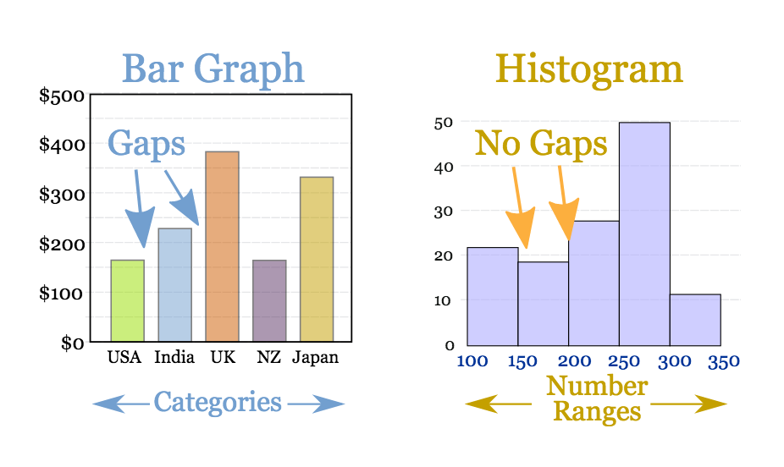
Questions to Guide EDA
Describing each variable:

Slide 32
Questions to Guide EDA
Describing relationships between each variable:
Is there a positive or negative relationship between two variables?
Measures of correlation (Pearson, Spearman, etc.)
Scatterplot, correlation tables, etc.
You can use the corr function in pandas for this.

Slide 33

Questions to Guide EDA
Measures of Correlation:
Pearson Correlation
$r_{xy}=\frac{cov(x,y)}{{SD}_{x}{SD}_{y}}$
Spearman Correlation
$r_{s_{xy}}=\frac{cov({rank}_{x},{rank}_{y})}{SD\left({rank}_{x}\right)SD({rank}_{y}) }$
Assesses the linear relationship between two variables
Assesses the monotonic relationship between two variables (whether linear or not)

Slide 34
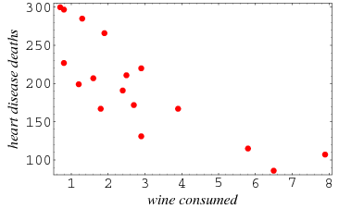
Questions to Guide EDA
Describing relationships between each variable:

Slide 35
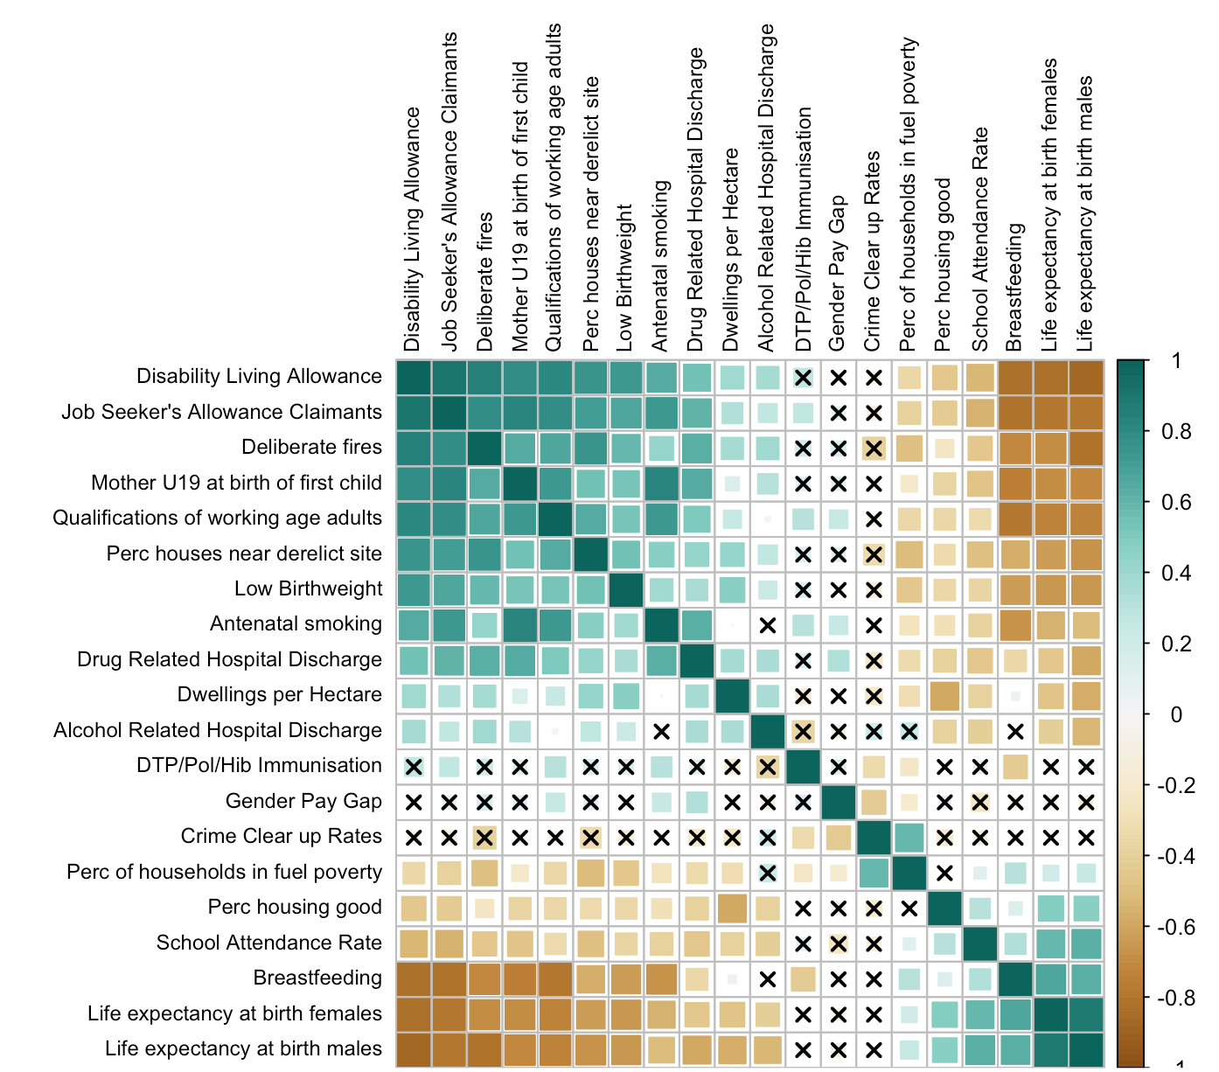
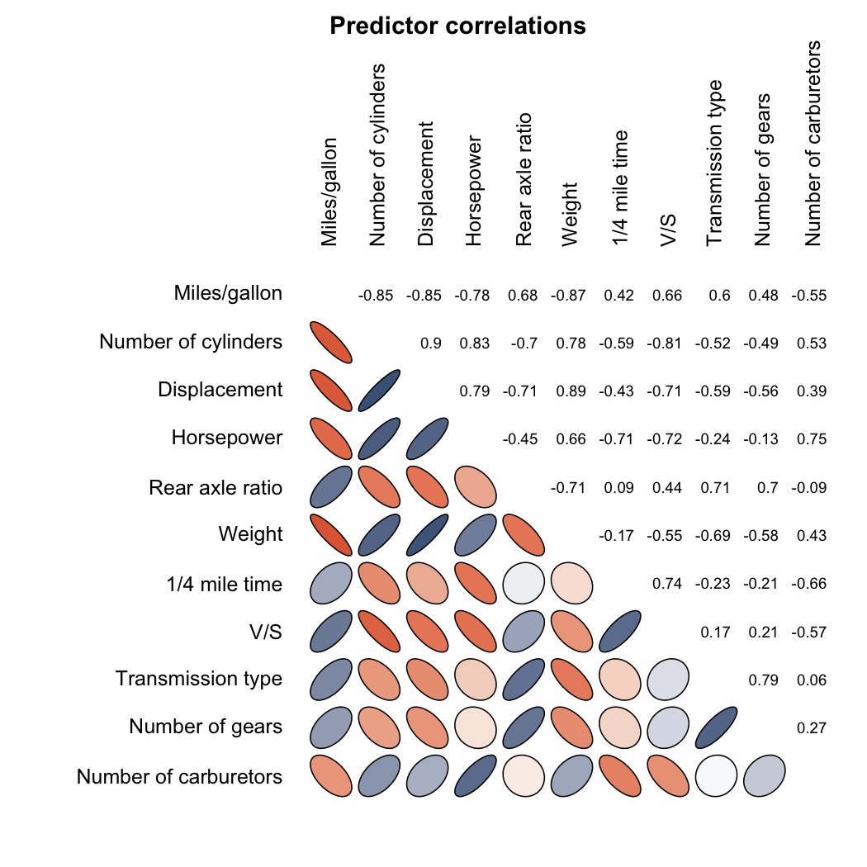
Questions to Guide EDA
Describing relationships between each variable:

Slide 36
Questions to Guide EDA
Regarding Additional Columns:
Are there additional columns you can add to the dataset?
Depending on the questions you want to answer
Compute as an index
poverty index
h-index
BMI
Feature pairs
male + old
cough + fever
Generated features
nearest grocery
nearest hospital
time duration
time since last log in
date difference
<feature> / period
<feature> % 1

Slide 37
Questions to Guide EDA
Regarding Outliers and Anomalies:
Are there outliers? Errors in encoding?
You should fix these using data cleaning techniques
Do you need to transform the data in order to visualize / process it properly?

Slide 38
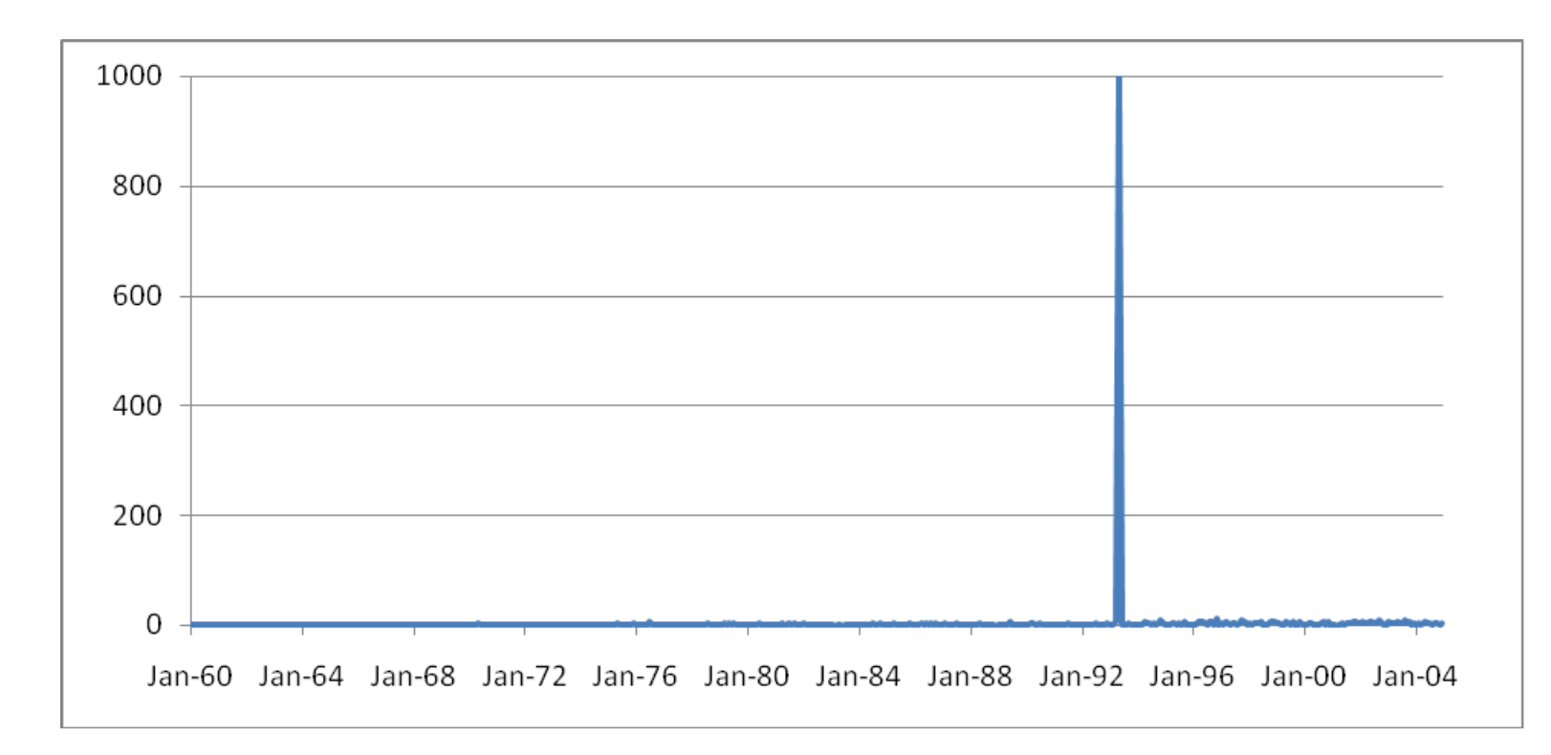
Questions to Guide EDA
Example of a Dataset Problem:
Do you notice anything strange with this data?
Maltz, M. D. (2010). Look before you analyze: Visualizing data in criminal justice. In Piquero, A. . and Weisburd, D., editors, Handbook of Quantitative Criminology, chapter 3, pages 25-52. Springer New York, New York, NY.
Data: Rape data in Boulder, CO (1960-2004)

Slide 39
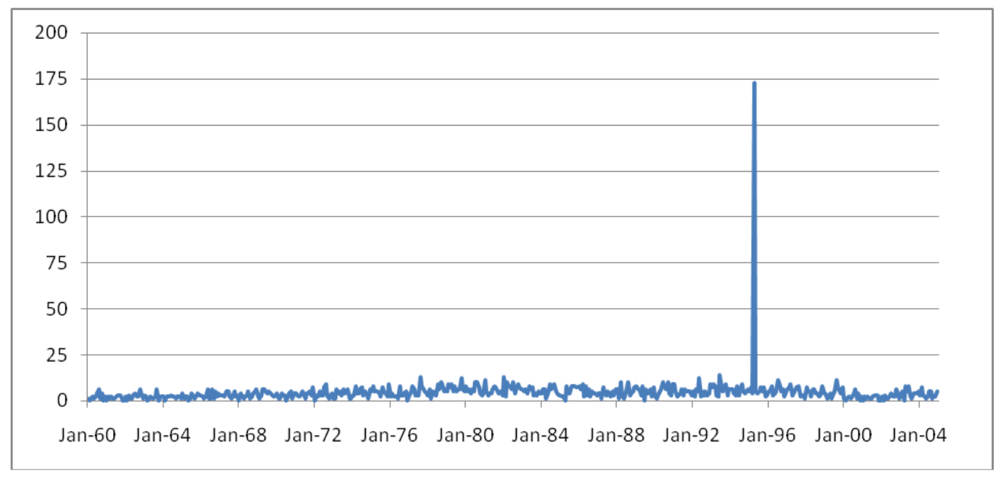
Questions to Guide EDA
Example of a Dataset Problem:
Do you notice anything strange with this data?
Maltz, M. D. (2010). Look before you analyze: Visualizing data in criminal justice. In Piquero, A. . and Weisburd, D., editors, Handbook of Quantitative Criminology, chapter 3, pages 25-52. Springer New York, New York, NY.
Data: Murder Data in Oklahoma City (1960-2004)

Slide 40
Cleaning and EDA on Labor Force Dataset
For this week, you will work on data from the Department of Labor and Employment (DOLE).
This data contains labor force information on various regions in the Philippines.
You will use pandas to clean the data and perform some exploratory data analysis processes on the data.

